Slide 1


Slide 2
Selenium Workshop

Slide 3
Selenium - Course Coverage
  What is Automation?
  What is Selenium?
  Modes of Selenium
  Selenium Flavors
  Overview of Selenium IDE
  Test Creation Demo with help of Selenium IDE
  Execution Mode-Test Runner Mode
  Executing & debugging the scripts
  Overview of Ruby
  Programming with Ruby
  Overview of Selenium RC
  Object Recognition
  Scripting and Execution using Selenium RC

Slide 4
What is Automation?
It is process of writing computer program to do testing.
Once tests have been automated, it can be executed unattended
Cost effective method
Long maintenance life
Virtually unlimited iterations of test case execution
Finding defects missed by manual testing
Customized reporting of application defects

Slide 5
What is Selenium?
A functional testing tool for web applications.
It runs tests via a real browser that is driven by a JavaScript engine which is called "the BrowserBot".
Works with any JavaScript-enabled browser
It is Open Source and Freeware.
Easy to Record Script and Play back of scripts
Allow Cross browser testing (Record in Firefox, Execute in IE)
No dedicated machine required for test execution( user can work in parallel)
Selenium uses JavaScript and IFrames to embed the BrowserBot in your browser
The engine is tweaked to support wide range of browsers on Windows, Mac OS X and Linux

Slide 6
Modes of Selenium
Selenium Runs in two modes:
Test Runner Mode
The framework and the tests themselves are deployed as Web pages inside the Web server under test.
It deploys a browser bot that runs alongside your application.
At that point, the BrowserBot engine is downloaded in your browser and is ready to process tests written as HTML tables.
Consequently, it will work with any javascript-enabled browser.

Slide 7
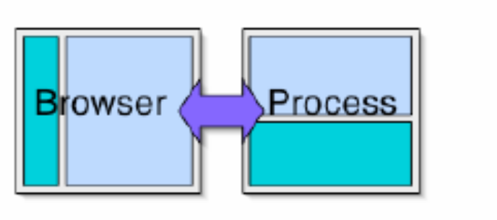
Modes of Selenium (Contd..
2. Driven Mode
It provides a way to automatically drive a browser from an application written in Python, Ruby, Java or .NET.
The Selenium framework provides "drivers" for these languages, which translate from a given language into "Selenese" commands that get fed to the BrowserBot engine inside the browser.

Slide 8
Selenium Flavors
Selenium Core
Selenium IDE
Selenium Remote Control
Selenium Grid

Slide 9
Selenium Core
  Utility for running tests in web browser
  Selenium HTML language is called Selenese
  Implemented in 100% Java
  Works on a large selection of browsers and operating systems
  One of the best features of Selenium Core is the ability of testing for browser compatibility.

Slide 10
Selenium IDE
    Selenium IDE is a Firefox plug in, allows you to record, play back, edit, and debug tests in browser.
    Selenium IDE is the only flavor of Selenium which allows you to record user actions on browser window.
    It can also record user actions in most of the popular languages like Java, C#, Perl, Ruby etc. This eliminates the need of learning new vendor scripting language. However to run them in an automated fashion you need to use Selenium Remote Control.

Slide 11
Selenium IDE (Contd…)
    Selenium default scripts are html (added JavaScript) and that is the script we are going to use it in selenium IDE
    The reason for availability of other language is, user can get the scripts for Selenium Remote Control.
    It also has a context menu (right-click) integrated with the Firefox browser, which allows the user to pick from a list of assertions and verifications for the selected location

Slide 12
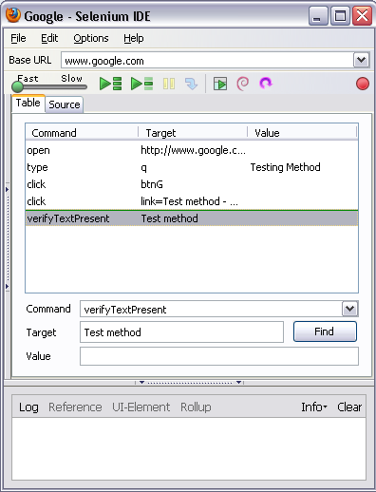
Steps for Installation of Selenium IDE:
  Download Selenium IDE.
  Copy Selenium IDE file to extensions folder of Mozilla Firefox.
  To facilitate opening of .xpi file for selenium you can drag and drop the .xpi file on the mozilla browser to install it and get it in the add-ons of the browser.

Slide 13
Selenium IDE Concepts
  There are 3 columns
  Command
  Target
  Value

Slide 14
Selenium IDE Concepts
  Command: A command that tells Selenium what to do. Selenium commands has
  three flavors:
  -> Actions
  -> Accessors
  -> Assertions
  Target : Element Locators tells Selenium that which HTML element a command refers to
  -> Element Locator
-> Patterns
  Value: Specify the value which user wants

Slide 15
Actions
Represent something a user can do
Manipulate the state of application
Actions generally come in 2 forms: action and actionAndWait
  action performs the action
  actionAndWait assumes a server call and thus waits long for a response
  open automatically wait

Slide 16
Assertions
Allows user to verify the state of the application
Three modes
  Assert – Upon failure, test is aborted
  Verify – Upon failure, the test continues running (logging the failure)
  waitFor
    Waits timeout time for a condition’s truthiness
    Great for testing background Ajax behavior

Slide 17
Accessors
Examine the state of the application and store the results in variables, e.g. "storeTitle". They are also used to automatically generate Assertions
Following are few accessors of Selenium:
  storeAlert ( variableName )
    Retrieves the message of a JavaScript alert generated during the previous action, or fail if there were no alerts.
  storeAllButtons ( variableName )
    Returns the IDs of all buttons on the page. If a given button has no ID, it will appear as "" in this array.
  storeAllFields ( variableName )
    Returns the IDs of all input fields on the page. If a given field has no ID, it will appear as "" in this array.
  storeAllWindowIds ( variableName )
    Returns the IDs of all windows that the browser knows about.

Slide 18
Element Locators
Types of Element Locators
Locating by identifier
Locating by id
Locating by name
Locating by X-path
Locating by DOM

Slide 19
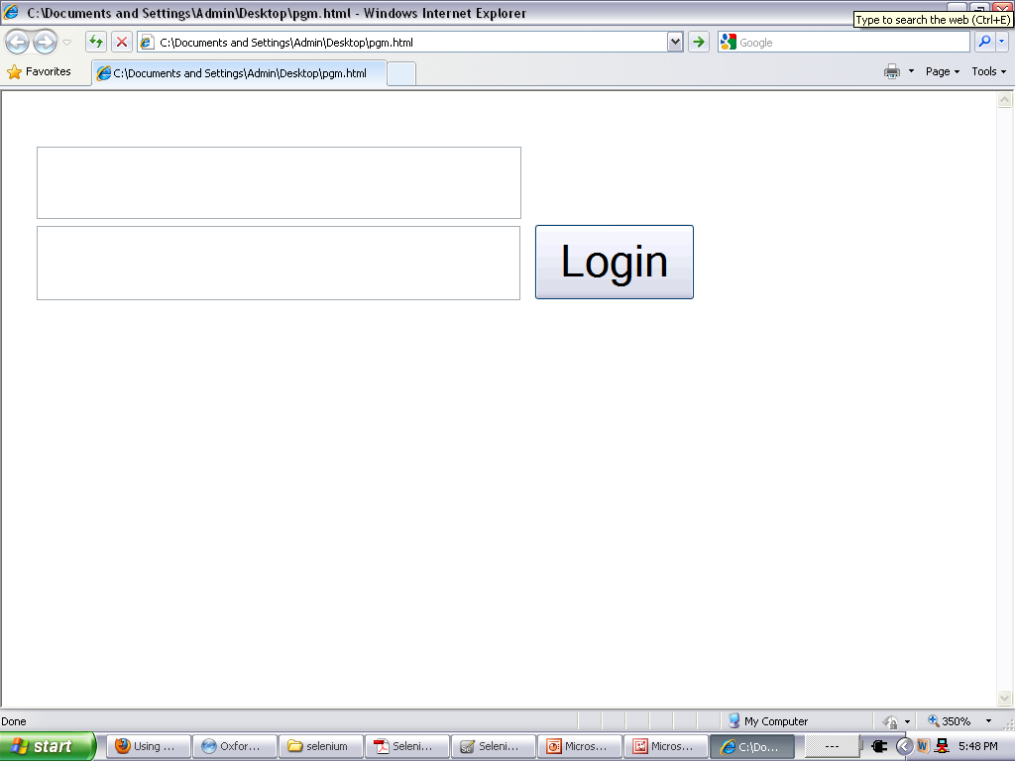
Locating by identifier
<html>
<body>
<form id= "loginForm" >
<input name= "username" type= "text" />
<input name= "password" type= "password" />
<input name= "continue" type= "submit" value= "Login" />
</form>
</body>
<html>
identifier=loginForm
identifier=password

Slide 20
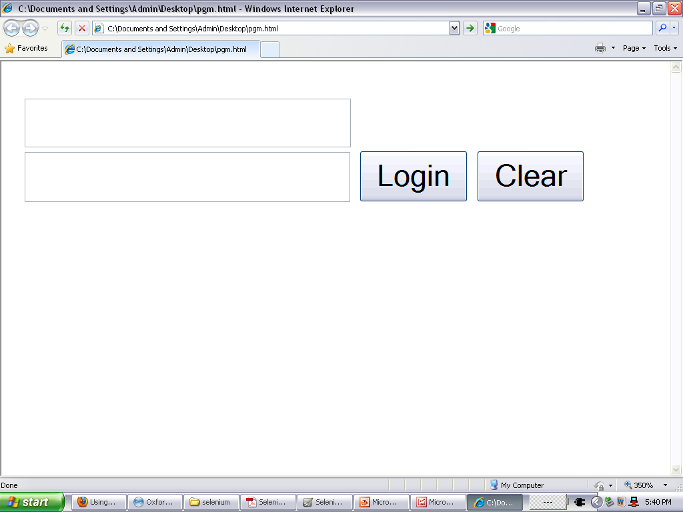
Locating by id
<html>
<body>
<form id= "loginForm" >
<input name= "username" type= "text" />
<input name= "password" type= "password" />
<input name= "continue" type= "submit" value= "Login" />
<input name= "continue" type= "button" value= "Clear" />
</form>
</body>
<html>
Id = loginForm

Slide 21
Locating by name
name=username
name=continue value=Clear
name=continue Clear
name=continue type=button
1 <html>
2 <body>
3 <form id= "loginForm" >
4 <input name= "username" type= "text" />
5 <input name= "password" type= "password" />
6 <input name= "continue" type= "submit" value= "Login" />
7 <input name= "continue" type= "button" value= "Clear" />
8 </form>
9 </body>
10 <html>

Slide 22
Locating by X-path
xpath=//form[@id=’loginForm’]
//input[@name=’username’]
Since only xpath locators start with “//”, it is not necessary to include the xpath= label when specifying an X-path locator.
<html>
<body>
<form id= "loginForm" >
<input name= "username" type= "text" />
<input name= "password" type= "password" />
<input name= "continue" type= "submit" value= "Login" />
<input name= "continue" type= "button" value= "Clear" />
</form>
</body>
<html>

Slide 23
Locating by DOM
The Document Object Model represents an HTML document and can be accessed using JavaScript.
This location strategy takes JavaScript that evaluates to an element on the page.
Since only dom locators start with “document”, it is not necessary to include the dom= label when
eg:
dom=document.getElementById(’loginForm’)
dom=document.forms[0]
document.forms[0].elements[0]
document.forms[0].elements[3]
<html>
<body>
<form id= "loginForm" >
<input name= "username" type= "text" />
<input name= "password" type= "password" />
<input name= "continue" type= "submit" value= "Login" />
<input name= "continue" type= "button" value= "Clear" />
</form>
</body>
<html>

Slide 24
Patterns
Patterns: Patterns allow you to describe, via the use of special characters, what text is expected rather than having to specify that text exactly.
glob:pattern
  Match a string against a “glob” pattern.
    “*” represents any sequence of character
    “?” represents any single character
  Glob patterns match against the entire string
regexp:regexp
  Match a string using a regular-expression.
  The full power of JavaScript regular-expression is available.
exact:string
  Match a string using a exact pattern
  The full power of JavaScript regular expressions is available.
If no pattern prefix is specified, Selenium assumes it’s a “glob” pattern

Slide 25
Patterns (Contd..)
Regular Expression:
Pattern | Match
. | Any single character
[ ] character class | any single character that appears inside the brackets
* quantifier | 0 or more of the preceding character(or group)
+ quantifier | 1 or more of the preceding character (or group)
? quantifier | 0 or 1 of the preceding character (or group)
{1,5} quantifier | 1 through 5 of the preceding character (or Group)

Slide 26
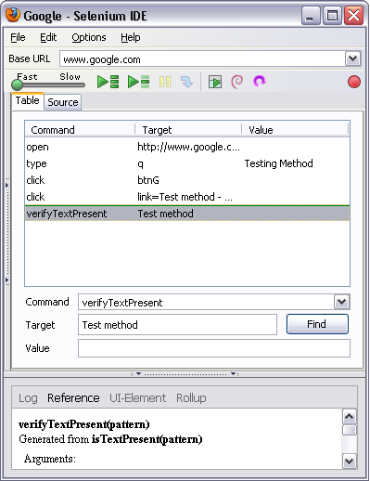
Components of Selenium IDE
Record Test Actions
Execution Commands
Try the test in the Web Based TestRunner
Reference of currently selected command
Specify commands, including Asserts

Slide 27
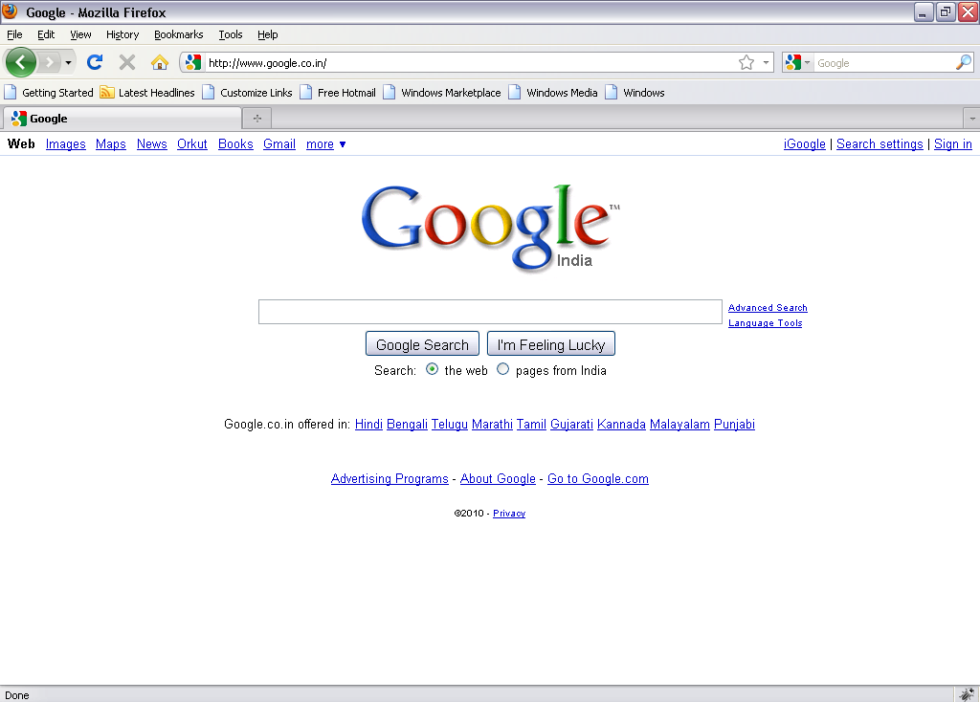
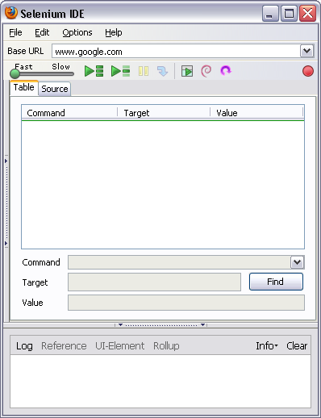
Test Creation Demo with help of Selenium IDE
Go to the Web Page for which you want to carry out the test
Hit the record button on IDE

Slide 28
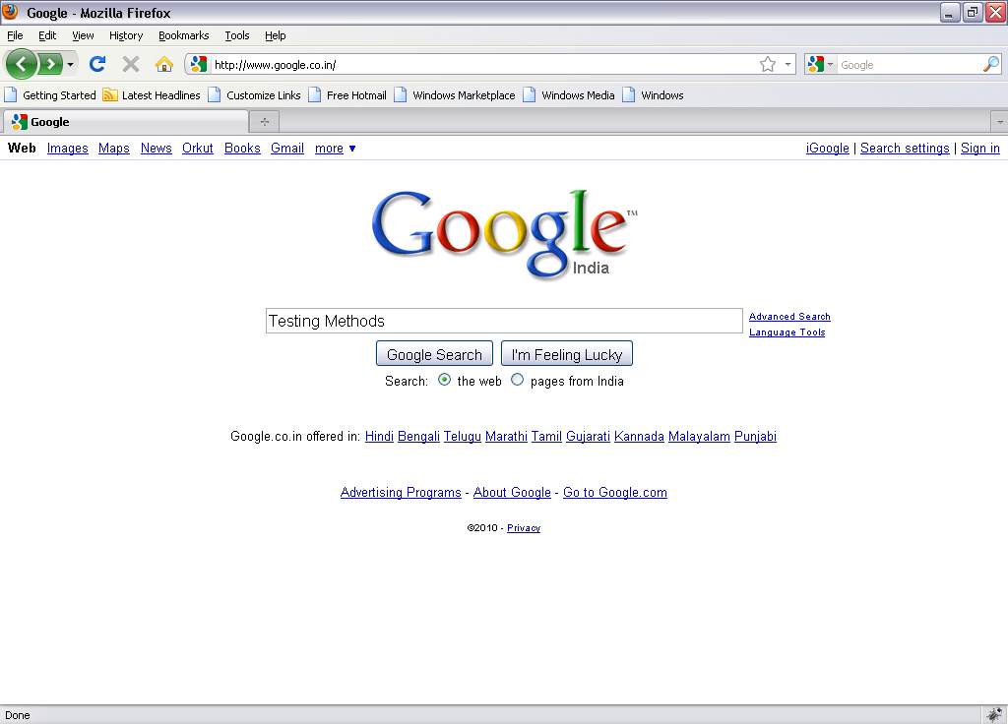
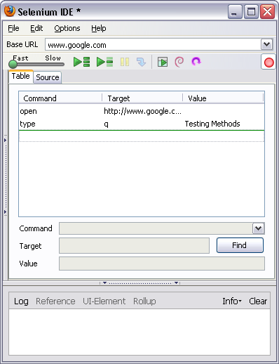
Test Creation Demo with help of Selenium IDE (Contd..
Enter the text on Web Page and submit
IDE should be updated, stop the recorder and add the assertions

Slide 29
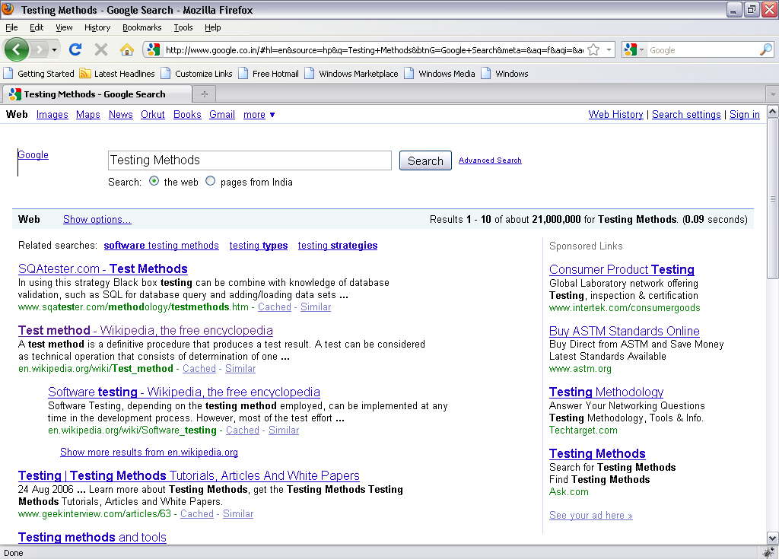
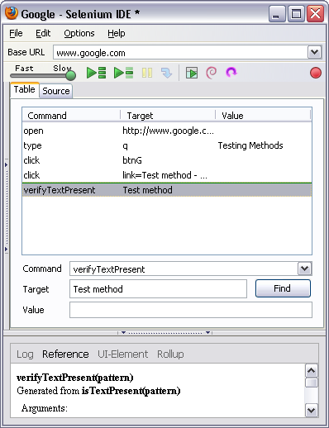
Test Creation Demo with help of Selenium IDE (Contd..
Play Button
Hit the play button to play the recorded scripts

Slide 30
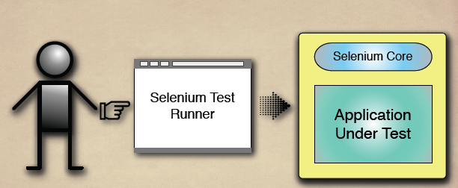
Test Runner mode of IDE

Slide 31
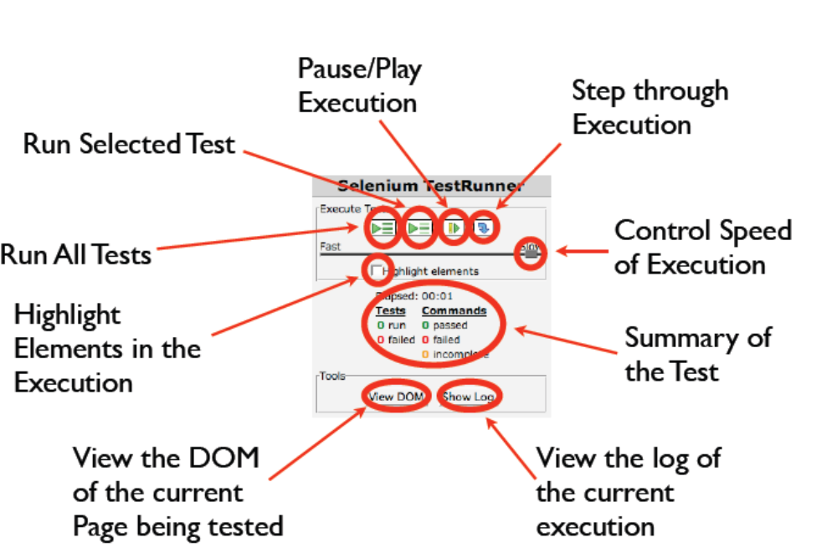
Test Runner and It’s Control

Slide 32
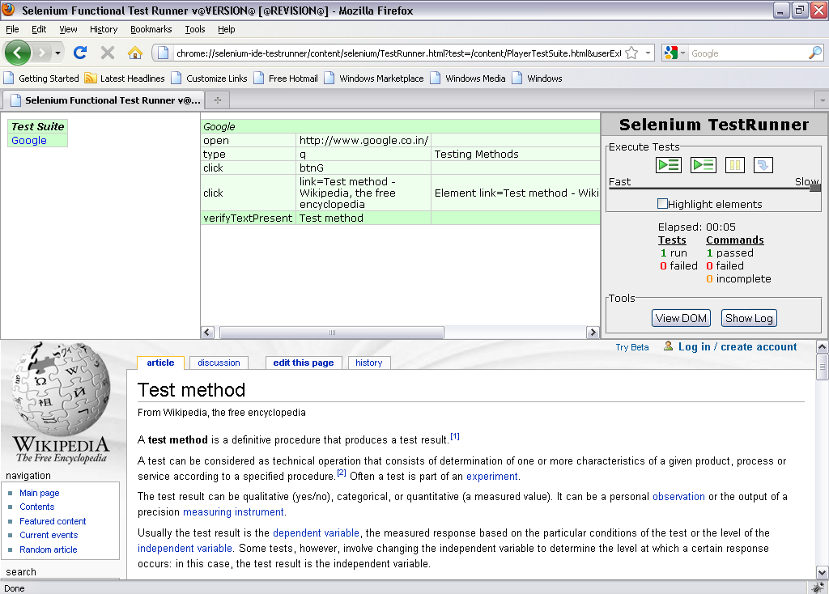
How to execute the Test Case in Test Runner mode.
Hit the play button to play the test script

Slide 33
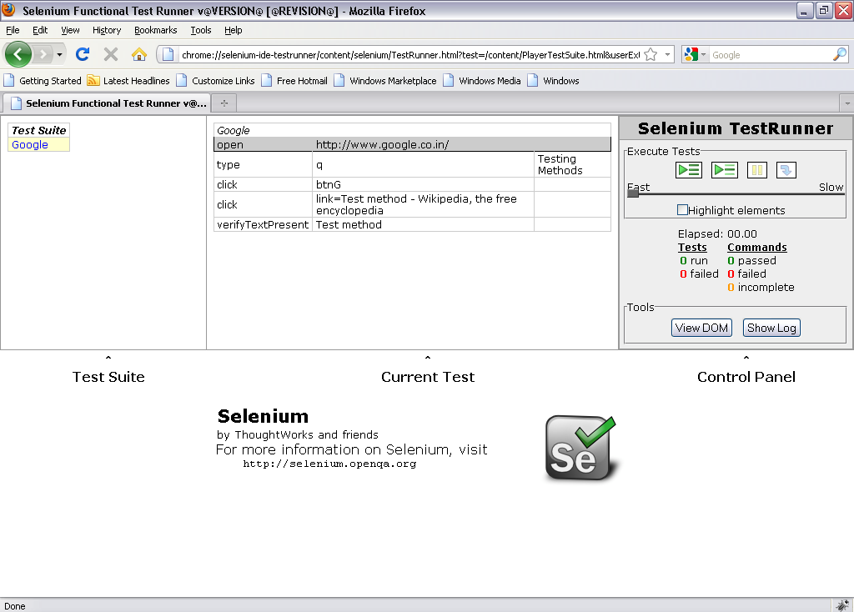
Execution & Debugging the scripts
Set Debug Point

Slide 34
Execution & Debugging the scripts (Contd..
Click on Run the Selected Test

Slide 35

Execution & Debugging the scripts (Contd..
Click on Steps

Slide 36
Execution & Debugging the scripts (Contd..

Slide 37
Overview of Ruby
Ruby is "an interpreted scripting language for quick and easy object-oriented programming";
interpreted scripting language:
  ability to make operating system calls directly
  powerful string operations and regular expressions
  immediate feedback during development
quick and easy:
  variable declarations are unnecessary
  variables are not typed
  syntax is simple and consistent
  memory management is automatic
object oriented programming:
  everything is an object
  classes, inheritance, methods, etc.
  singleton methods
  mixing by module
  iterators and closures
Ruby file has .rb extension

Slide 38
Programming with Ruby
Functions/Methods
Output:
  def sayGoodMorning(name)
  result = "GoodMorning, " + name
  return result
  end
  # Time to say good morning
  puts sayGoodMorning("John")
  puts sayGoodMorning("Mary")
GoodMorning, John
GoodMorning, Mary

Slide 39
Programming with Ruby (Contd..
Arrays
Empty Array
a = [ 1, 'cat', 3.14 ] # array with three elements
# access the first element
a[0] » 1
# set the third element
a[2] = nil
# dump out the array
a » [1, "cat", nil]
empty1 = []
empty2 = Array.new

Slide 40
Programming with Ruby (Contd..
If Statement
Output: poor
x=2
if x==10
puts("Good")
elsif x>10
puts("Very Good")
else
puts("Poor")
End

Slide 41
Programming with Ruby (Contd..
While Statement
Output: 3
x=1
while x<2
x=x+1*2
end
puts x

Slide 42
Programming with Ruby (Contd..
Regular Expression
Output:
strtext="Hello, How are you?,Hello Good morning"
if strtext=~ /Hello|Hi/
puts "Text Matched,#{strtext}"
else
puts "No match found"
end
#Replace character matched with Regular Expression
puts strtext.sub(/Hello/,'Hi') #replace first 'Hello' with 'Hi'
puts strtext.gsub(/Hello/,'Hi') #replace every 'Hello' with 'Hi'
Text Matched,Hello, How are you?,Hello Good morning
Hi, How are you?,Hello Good morning
Hi, How are you?,Hi Good morning

Slide 43
Programming with Ruby (Contd..
Class, object & Attributes
Output
class Newsong
def initialize(name,artist,duration)
@name=name
@artist=artist
@duration=duration
end
def name
@name
end
def artist
@artist
end
def duration
@duration
end
end
objsong=Newsong.new("Dilse","Rehman",260)
puts objsong.name
puts objsong.artist
puts objsong.duration
Dilse
Rehman
260

Slide 44
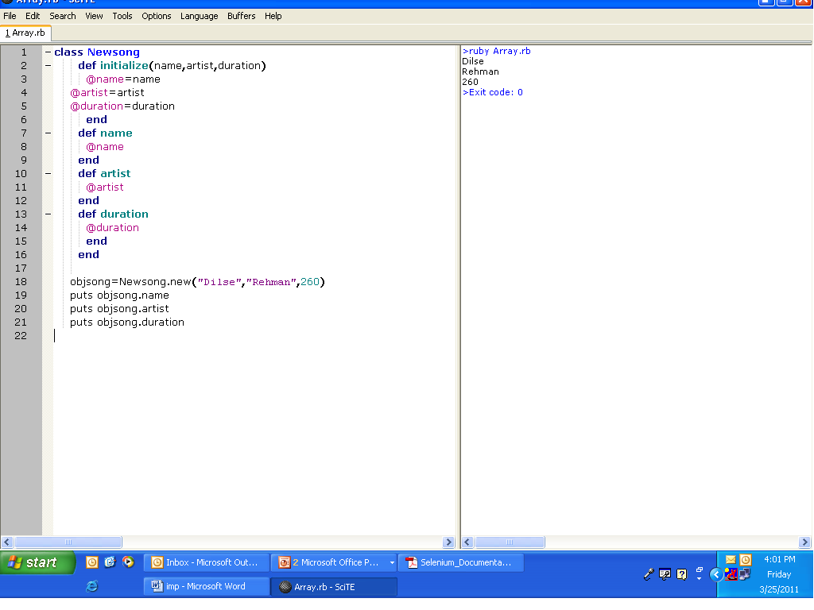
Array output

Slide 45
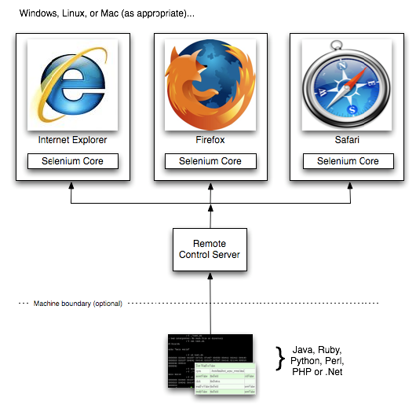
Overview of Selenium RC
Consists of two parts:
1. Selenium Server
2. Selenium Client Drivers for Java, .Net, Perl, Ruby and Python
Allows you to write automated tests in any language against any HTTP website using any JavaScript-enabled browser.

Slide 46
Selenium RC (Contd..
SELENIUM SERVER
Can automatically start/stop/control any browser.
Works by using Selenium Core.
You can communicate with the server using HTTP GET/POST request.
Communicates directly with the browser using XmlHttpRequest.
Selenium Server acts as a client-configured HTTP proxy to stand in between browser and web application.

Slide 47
Selenium RC (Contd..
SELENIUM CLIENT-DRIVER
To write automated scripts in any language.
Interaction with the Selenium RC Server.
Since it is open source you can create your own client driver.
Can create a selenium object in your automation script which can interact with the browser.
DefaultSelenium object has methods that handle Selenium commands.
Use Client-Driver with Testing Framework like JUnit.

Slide 48
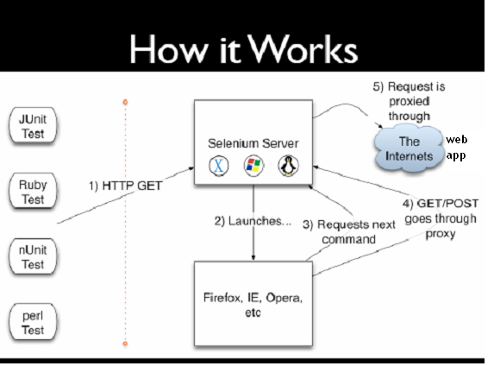
How Selenium RC works

Slide 49
How Selenium RC works (Contd..
Selenium gets an HTTP request from external framework like JUnit, nUnit, PerlUnit,etc
Selenium Server creates a session id and launches browser with that id
Browser sends the request/commands to the server with the help of the session id
Request is proxied through the Internet and your Application Under Test is launched
Selenium Remote Control can read the data from the external files.

Slide 50
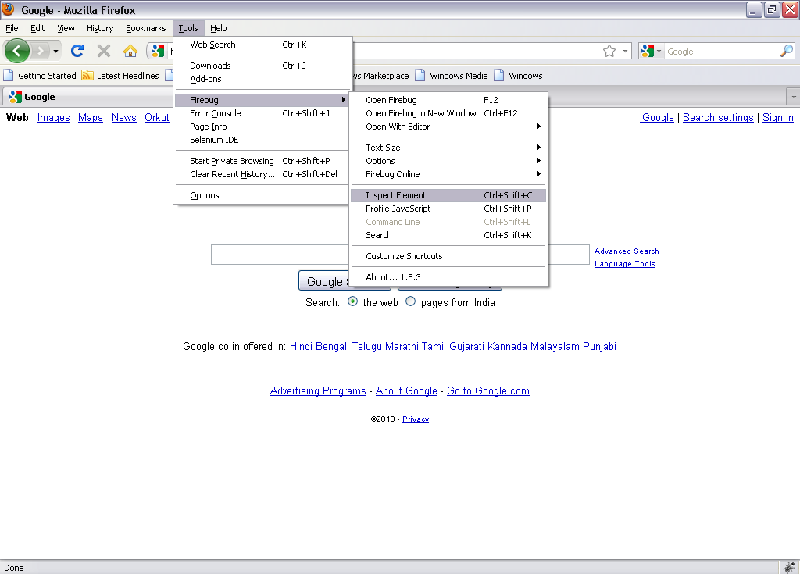
Object Recognition
It is using Fire bug to recognize the objects.

Slide 51
Object Recognition (Contd..
Steps to Highlight the objects using Firebug
  Open Mozilla Firefox.
  Go to Tools → Click on Firebug → Click on Inspect Element
  Move mouse curser over the controls
  You can see highlighted control in Firebug window.

Slide 52
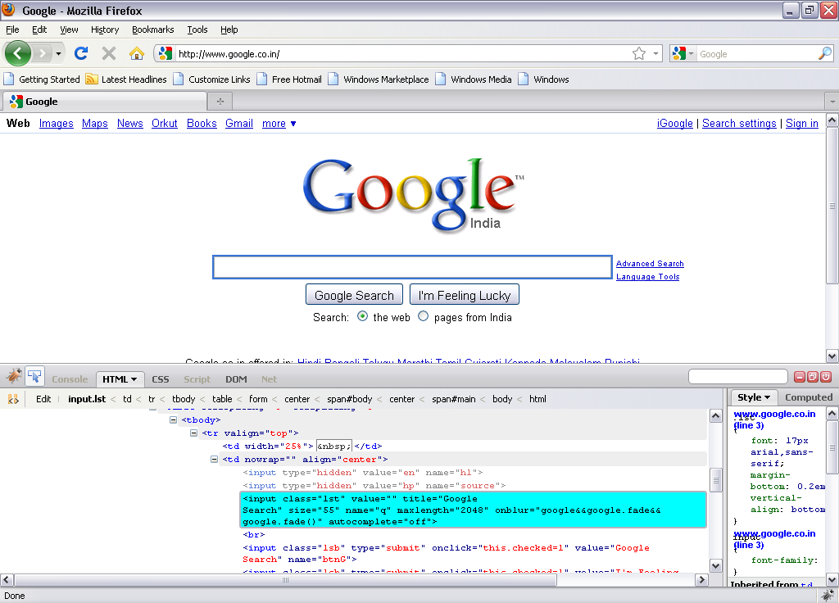
Object Recognition (Contd..

Slide 53
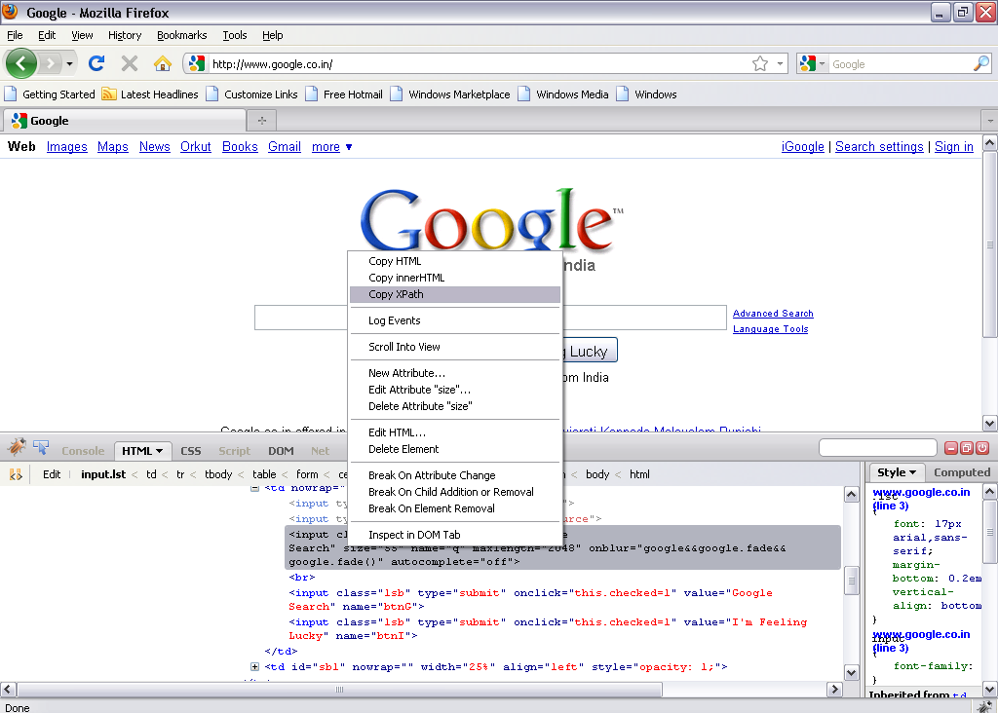
Object Recognition (Contd..

Slide 54
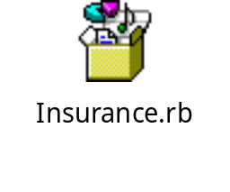
Scripting and Execution using Selenium RC
Scripting
Import Required files
Create Class
Create three methods/functions
  Setup()
    Used to initialize the selenium object.
  Teardown()
    Used to cleanup the selenium object after each test
  Test_filename
    Used to write business logic.
Execution
To execute ruby script, press F5

Slide 55
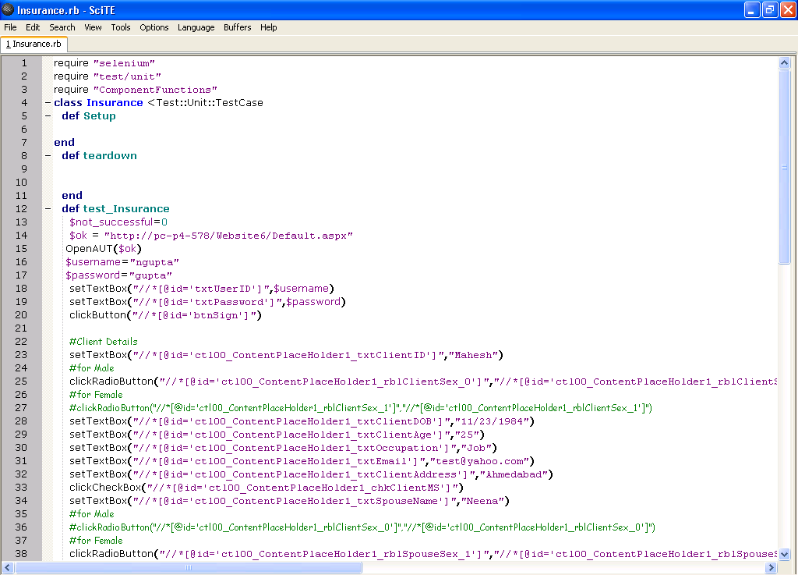
Scripting and Execution using Selenium RC (Contd..
Import Required Files
Import Required Files
Create Class
Setup Method
Teardown Method
Teardown Method
Test_Insurance Method

Slide 56
Thank You

